Slide 1
20241014 scratch issue

Slide 2
Discipline 1. 選定團隊 Form the Team
團隊負責人Team Leader/Dept.:
成員Team Member/Dept.:
Name | Department | Position

Slide 3
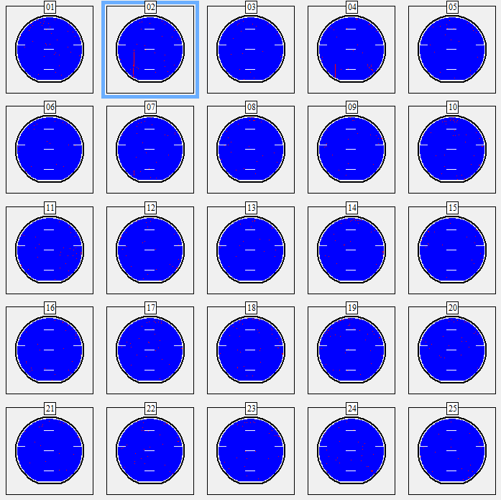
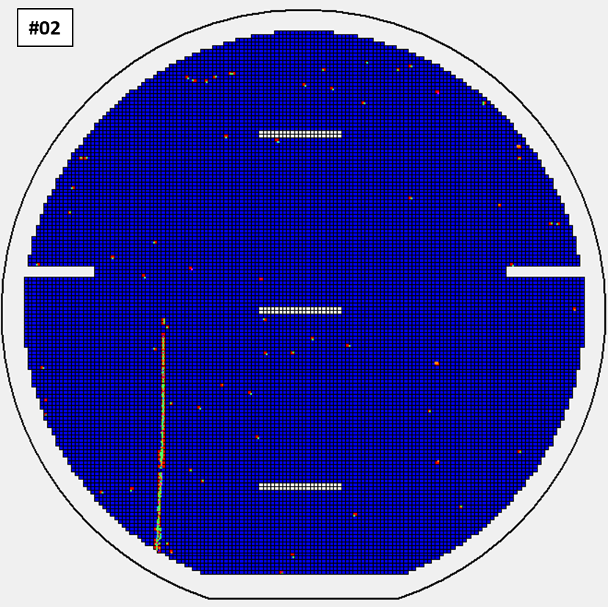
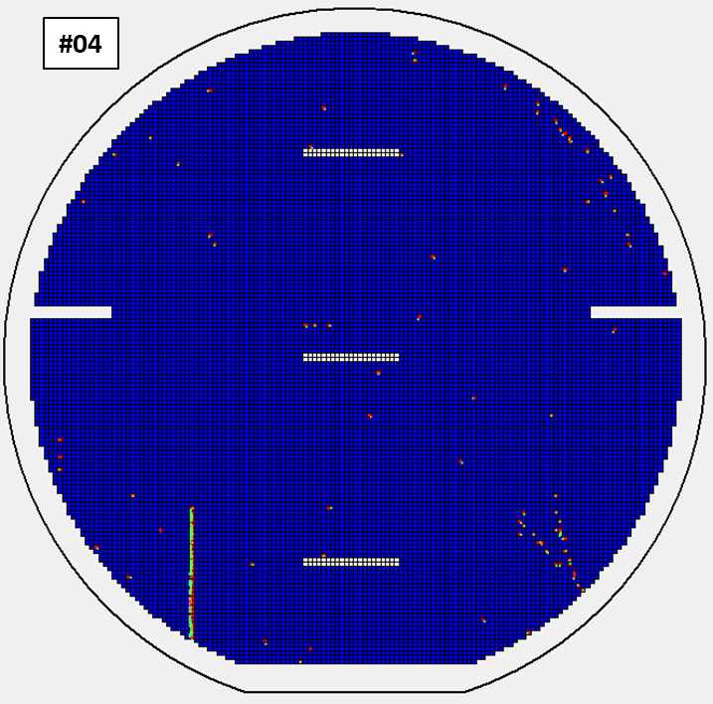
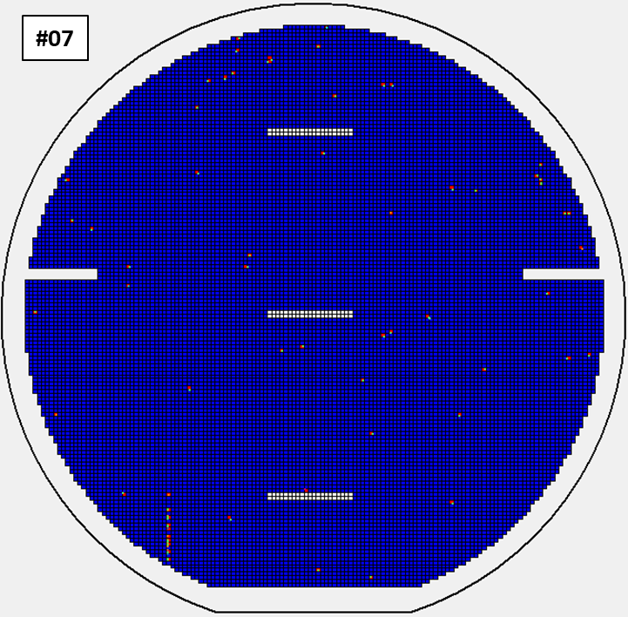
Discipline 2.描述問題及現況掌握Describe the Problem
(WHO detected the problem? WHAT is wrong? State the problem in terms of object and defect. WHERE the problem was first detected, describe location of the detection, lot #, WHEN and HOW it was detected)
What | L054AI-YBS05V-24400350 #2,#4,#7線性刮傷 Total impact: 1 lots/3 pcs
Where | Op.6533
When | 2024/10/14
Extent | AOI scan inform : 24400350 #2,4,7線性刮傷

Slide 4
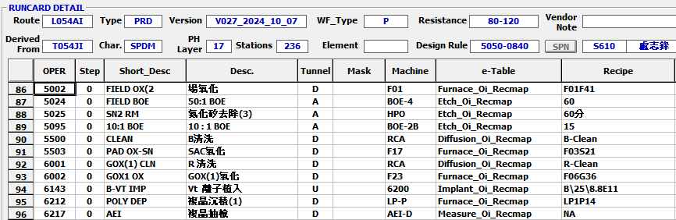
Run cards at impact station
24400350 check on-hold record: no on-hold record

Slide 5
Discipline 2.描述問題及現況掌握Describe the Problem
Is/Is Not table (釐清問題):
 |  | Is | Is Not
What | object
 | Defect
Where | Location
 | Machine
When | First time
 | Reoccurred
How | Many
 | Trend

Slide 6
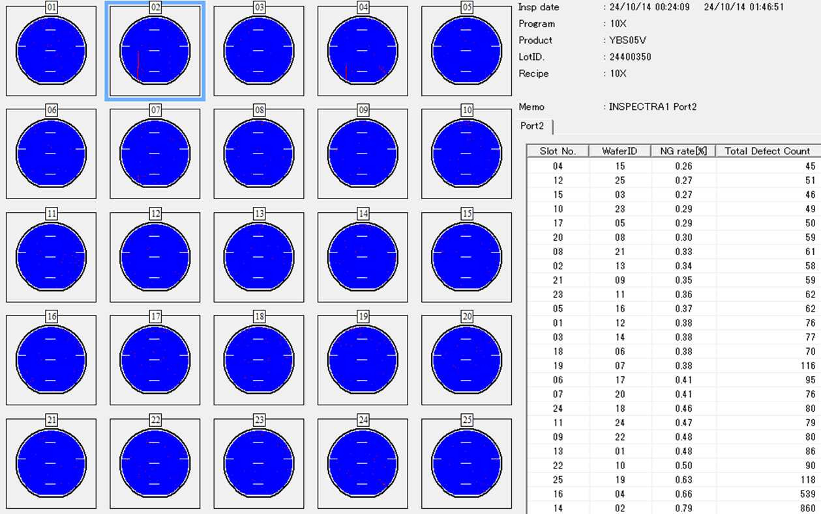
Discipline 2.描述問題及現況掌握Describe the Problem
(WHO detected the problem? WHAT is wrong? State the problem in terms of object and defect. WHERE the problem was first detected, describe location of the detection, lot #, WHEN and HOW it was detected)
AOI scan 通知:
L054AI-YBS05V-24400350-6533_op (spec < 5%)
#02,04,07 by line map, total impact 3 pcs

Slide 7
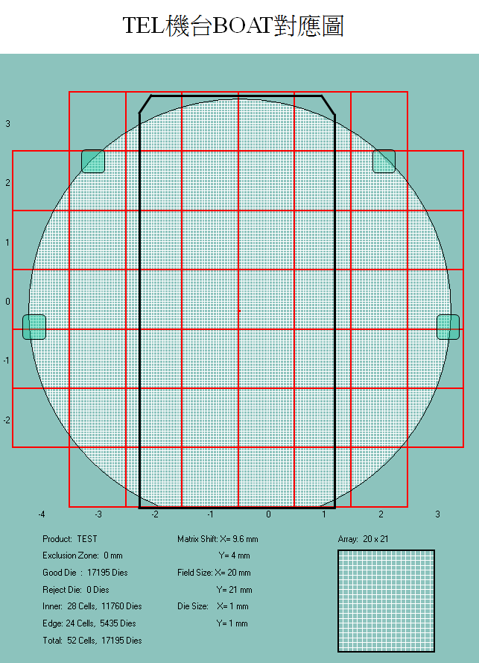
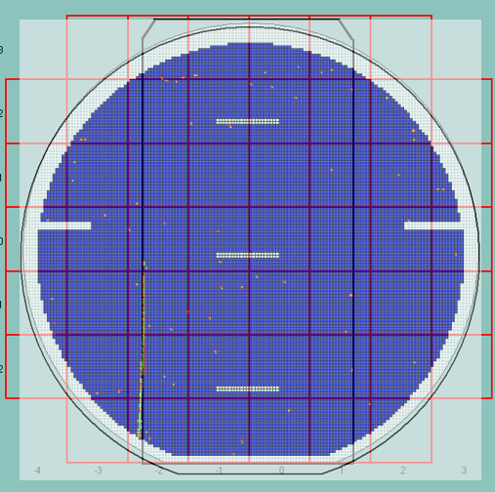
Discipline 2.描述問題及現況掌握Describe the Problem
(WHO detected the problem? WHAT is wrong? State the problem in terms of object and defect. WHERE the problem was first detected, describe location of the detection, lot #, WHEN and HOW it was detected)
AOI scratch vs. robot map match

Slide 8
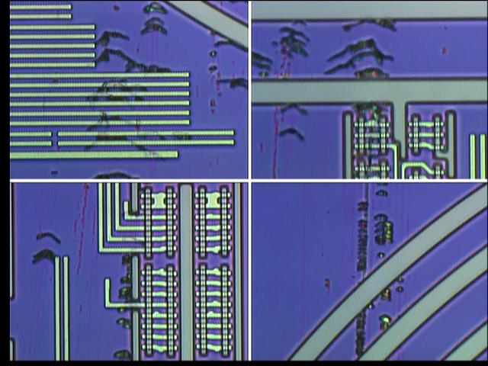
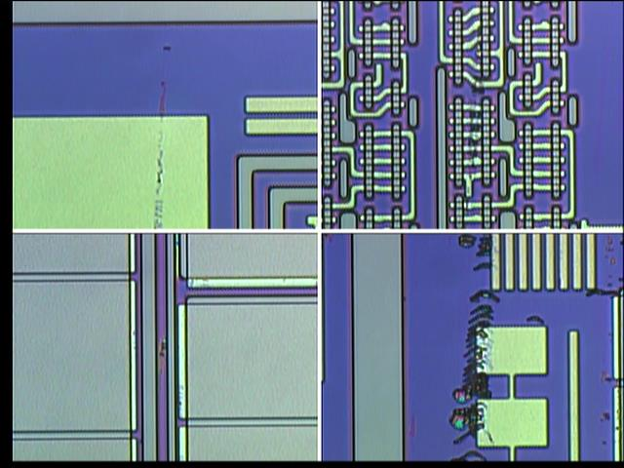
Discipline 2.描述問題及現況掌握Describe the Problem
(WHO detected the problem? WHAT is wrong? State the problem in terms of object and defect. WHERE the problem was first detected, describe location of the detection, lot #, WHEN and HOW it was detected)
Leica Pictures OM Check: #02 By scratch Issue~6.5cm scrap FA

Slide 9
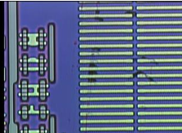
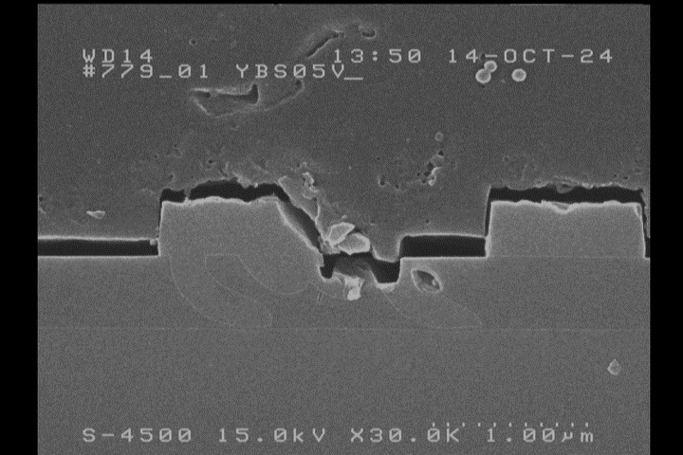
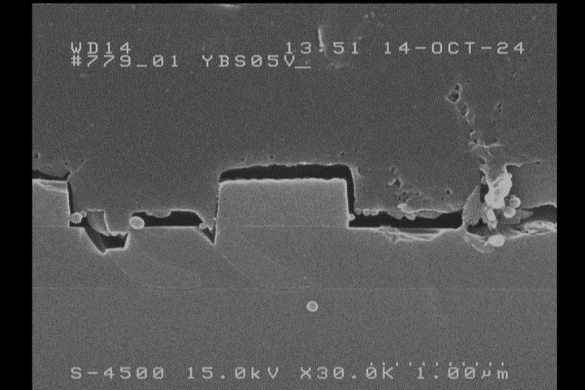
Discipline 2.描述問題及現況掌握Describe the Problem
(WHO detected the problem? WHAT is wrong? State the problem in terms of object and defect. WHERE the problem was first detected, describe location of the detection, lot #, WHEN and HOW it was detected)
poly
poly
Poly灌入
Poly灌入
FA result : Field OX 刮傷,底層介面完整, Poly倒灌 suppose by FOX-Dep issue

Slide 10
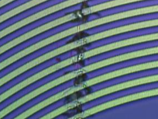
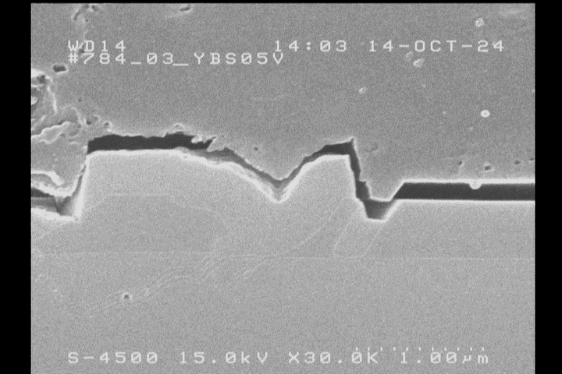
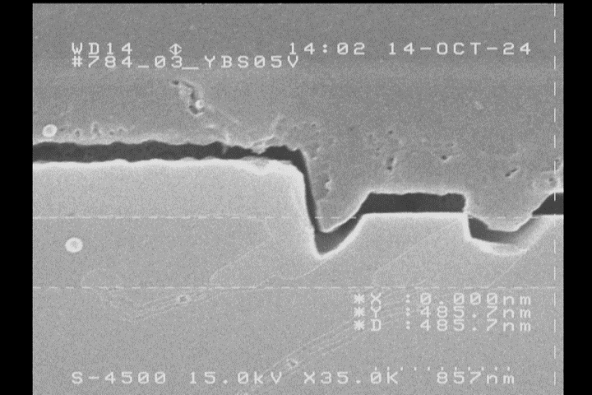
Discipline 2.描述問題及現況掌握Describe the Problem
(WHO detected the problem? WHAT is wrong? State the problem in terms of object and defect. WHERE the problem was first detected, describe location of the detection, lot #, WHEN and HOW it was detected)
FA result : Field OX 刮傷, Poly倒灌 suppose by FOX-Dep issue

Slide 11
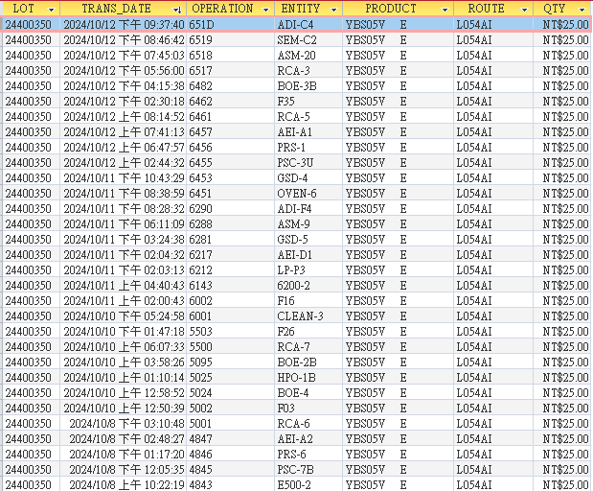
Discipline 2.描述問題及現況掌握Describe the Problem
(WHO detected the problem? WHAT is wrong? State the problem in terms of object and defect. WHERE the problem was first detected, describe location of the detection, lot #, WHEN and HOW it was detected)
L054AI-YBS05V-24400350 lot history
OP. 5001~6533 , 從SEM推測FOX後之刮傷較可能之爐管機台: F03、F26、F16

Slide 12
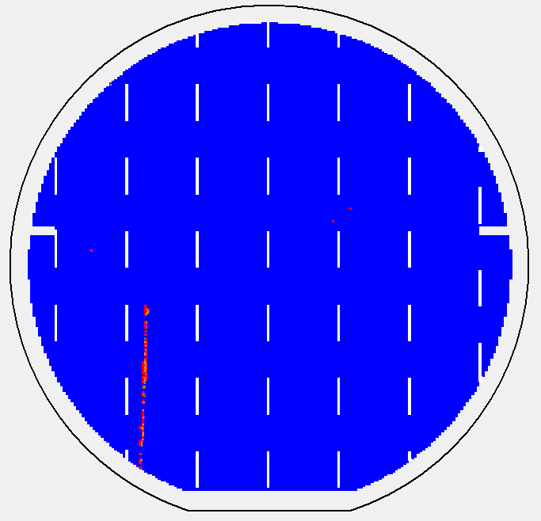
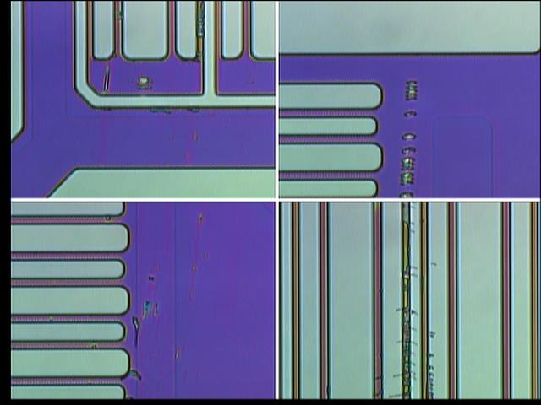
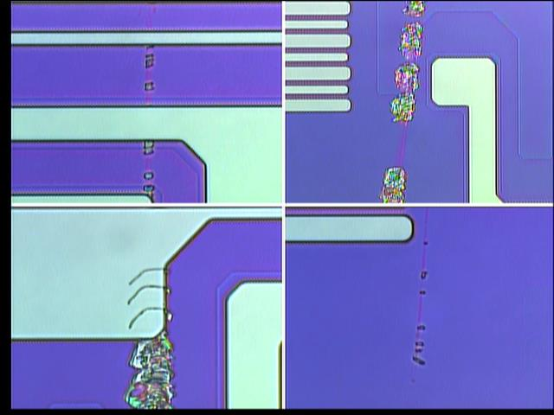
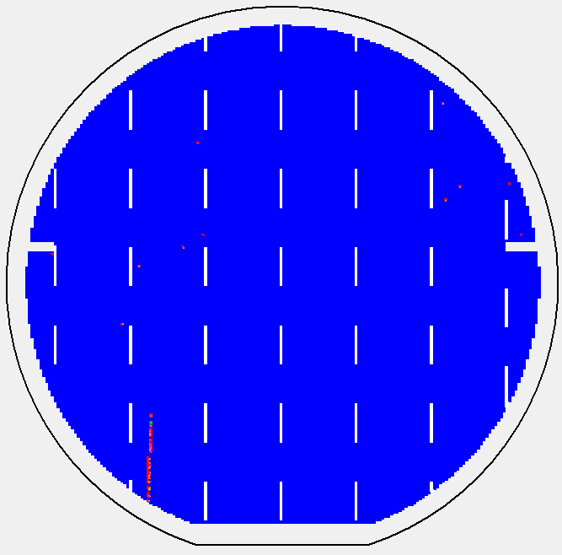
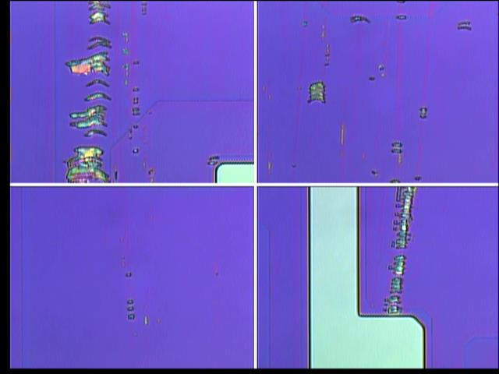
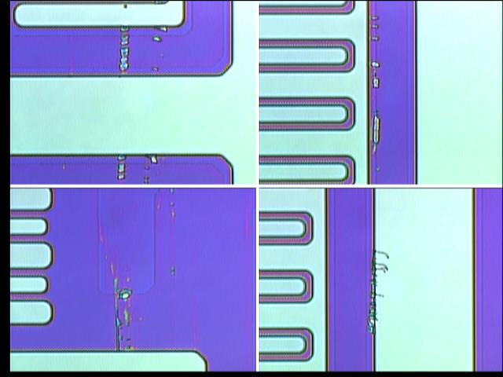
#2
#4

Slide 13
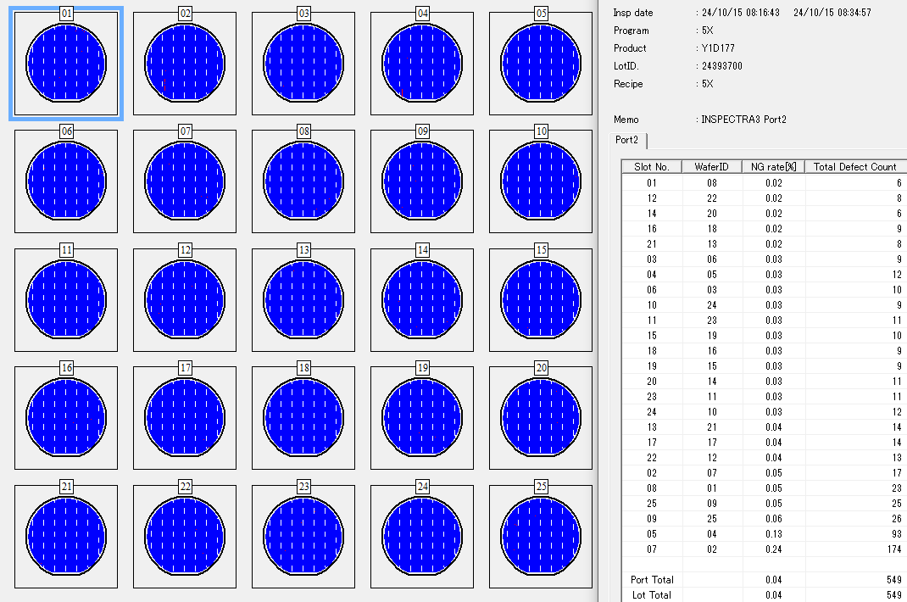
24393700-C089JI-Y1D177-8701-op
AOI scan defect rate: 0.02~0.24%
OM check #2, 4 by scratch issue
Product for S200 check

Slide 14
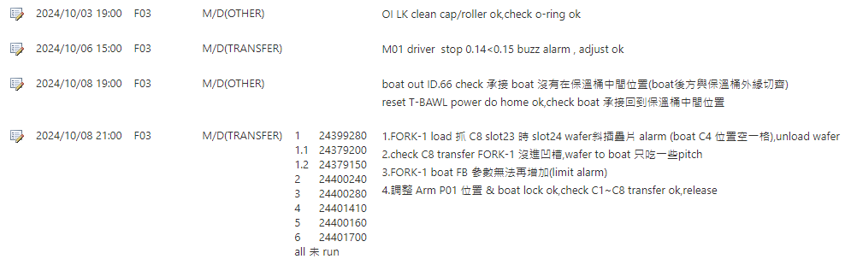
Discipline 2.描述問題及現況掌握Describe the Problem
(WHO detected the problem? WHAT is wrong? State the problem in terms of object and defect. WHERE the problem was first detected, describe location of the detection, lot #, WHEN and HOW it was detected)
Issue date : F03 Move-in 10/9 14:56
F03 10/8 FORK-1 transfer alarm issue

Slide 15
Discipline 2.描述問題及現況掌握Describe the Problem
(WHO detected the problem? WHAT is wrong? State the problem in terms of object and defect. WHERE the problem was first detected, describe location of the detection, lot #, WHEN and HOW it was detected)
F03 刮傷 lot : 24393700 , 24400350 , total= 2 lot/5pcs
Issue 前/當 batch run : 24400160 , 24400320 AOI map no scratch
共同 zone : C1 zone
Trans_Date | Entity | Location | Lot | Route | Oper | Recipe | Product | Qty | CURR OPER | GRADE | PROGRAM | EQID | AOI SCAN OPER | Note
10/8/2024 11:46 | F03 | 1 | 24379160 | T056VI | 5059 | F03F41 | Y4R01T B | 12 | 6418 | H
10/8/2024 11:46 | F03 | 1.1 | 2437915B | T056UI | 5059 | F03F41 | Y7E04T F | 1 | 6552 | H
10/8/2024 11:46 | F03 | 2 | 24400290 | L054AI | 5002 | F03F41 | YBS05V E | 25 | 7746 | A
10/8/2024 11:46 | F03 | 3 | 24382210 | T056JI | 5059 | F03F41 | Y7E03T C | 25 | 6199 | H
10/8/2024 11:46 | F03 | 4 | 24382250 | T056JI | 5059 | F03F41 | Y7E03T C | 25 | 6178 | B
10/8/2024 11:46 | F03 | 5 | 24400380 | L054AI | 5002 | F03F41 | YBS05V E | 25 | 7718 | A
10/8/2024 11:46 | F03 | 6 | 24400130 | L054AI | 5002 | F03F41 | YBS05V H | 25 | 7541 | A
F03 FORK-1 transfer issue |  |  |  |  |  | F03 FORK-1 transfer issue
10/9/2024 0:37 | F03 | 1 | 24379200 | D056TI | 5059 | F03F41 | YBF06T B | 4 | 6421 | H
10/9/2024 0:37 | F03 | 1.1 | 24379150 | T056UI | 5059 | F03F41 | Y7E04T E | 3 | 6552 | H
10/9/2024 0:37 | F03 | 1.2 | 24399280 | T050QI | 5002 | F03F41 | YBK10V A | 13 | 6462 | A
10/9/2024 0:37 | F03 | 2 | 24400240 | L054AI | 5002 | F03F41 | YBS05V E | 25 | 7545 | A
10/9/2024 0:37 | F03 | 3 | 24400280 | L054AI | 5002 | F03F41 | YBS05V E | 25 | 7718 | A
10/9/2024 0:37 | F03 | 4 | 24401410 | T050HI | 5002 | F03F41 | Y7E24V A | 25 | 7438 | A
10/9/2024 0:37 | F03 | 5 | 24400160 | L054AI | 5002 | F03F41 | YBS05V E | 25 | 7102 | A | 5X | AOI-1 | 6517 (0.03% ~ 0.69%) | AOI map normal
10/9/2024 0:37 | F03 | 6 | 24401700 | T050HI | 5002 | F03F41 | Y7E24V A | 25 | 7438 | A |  |  |  | FH wait AOI check
10/9/2024 6:48 | F03 | 1 | 24393700 | C089JI | 5002 | F03F02 | Y1D177 D | 25 | 8704 | B | 5X | AOI-3 | 8701 (0.02% ~ 0.24%) | #2,4 刮傷 , #2 >6cm
10/9/2024 6:48 | F03 | 2 | 24393830 | C089JI | 5002 | F03F02 | Y1D177 D | 25 | 8718 | B
10/9/2024 6:48 | F03 | 3 | 24393850 | C089JI | 5002 | F03F02 | Y1D177 D | 25 | 8718 | B
10/9/2024 6:48 | F03 | 4 | 24393940 | C089JI | 5002 | F03F02 | Y1D207 B | 25 | 8718 | B
10/9/2024 6:48 | F03 | 5 | 24394000 | C089JI | 5002 | F03F02 | Y1D137 A | 25 | 8719 | B
10/9/2024 6:48 | F03 | 6 | 24394060 | C089JI | 5002 | F03F02 | Y1D137 A | 25 | 8709 | B
10/9/2024 14:56 | F03 | 1 | 24400350 | L054AI | 5002 | F03F41 | YBS05V E | 25 | 7412 | A | 10X | AOI-1 | 6533 (0.26% ~ 0.79%) | #2,4,7 刮傷 , #2 >6.5cm
10/9/2024 14:56 | F03 | 2 | 24401620 | T050HI | 5002 | F03F41 | Y7E24V A | 25 | 7318 | A
10/9/2024 14:56 | F03 | 3 | 24401250 | T050EI | 5002 | F03F41 | YCE06V A | 25 | 7412 | A
10/9/2024 14:56 | F03 | 4 | 24400320 | L054AI | 5002 | F03F41 | YBS05V E | 25 | 7412 | A | 10X | AOI-1 | 6533 (0.29% ~ 0.91%) | AOI map normal
10/9/2024 14:56 | F03 | 5 | 24401200 | T050EI | 5002 | F03F41 | YCE06V A | 25 | 7320 | A
10/9/2024 14:56 | F03 | 6 | 24401480 | T050HI | 5002 | F03F41 | Y7E24V A | 25 | 7425 | A
10/9/2024 21:39 | F03 | 1 | 24382470 | T056JI | 5059 | F03F41 | Y7E03T C | 25 | 6044 | B
10/9/2024 21:39 | F03 | 2 | 24401510 | T050HI | 5002 | F03F41 | Y7E24V A | 25 | 7341 | A
10/9/2024 21:39 | F03 | 3 | 24401440 | T050HI | 5002 | F03F41 | Y7E24V A | 25 | 7430 | A
10/9/2024 21:39 | F03 | 4 | 24401230 | T050EI | 5002 | F03F41 | YCE06V A | 25 | 7346 | A
10/9/2024 21:39 | F03 | 5 | 24401770 | T050HI | 5002 | F03F41 | Y7E24V A | 25 | 7412 | A
10/9/2024 21:39 | F03 | 6 | 24400230 | L054AI | 5002 | F03F41 | YBS05V E | 25 | 7318 | A

Slide 16
Discipline 2.描述問題及現況掌握Describe the Problem
(WHO detected the problem? WHAT is wrong? State the problem in terms of object and defect. WHERE the problem was first detected, describe location of the detection, lot #, WHEN and HOW it was detected)
F03 10/7~10/14 C1 zone 共掃 5批 , 目前只影響 2批
Impact 時間: 10/9~10/10
24382470 FH wait AOI check
Trans_Date | Entity | Location | Lot | Route | Oper | Recipe | Product | Qty | CURR OPER | GRADE | PROGRAM | EQID | AOI SCAN OPER | Note
10/7/2024 4:07 | F03 | 1 | 24392520 | T050QI | 5503 | F03S21 | YBK08V A | 25 | 7742 | B | 10X | AOI-3 | 6533 (0.36% ~ 1.19%) | AOI map normal
10/7/2024 8:36 | F03 | 1 | 24401980 | T050HI | 1812 | F03S21 | Y7E24V A | 25 | 6288 | B | 5X | AOI-3 | 4533 (0.01% ~ 0.04%) | AOI map normal
10/7/2024 13:19 | F03 | 1 | 24393970 | C089JI | 5002 | F03F02 | Y1D137 A | 25 | 8718 | B
10/7/2024 21:23 | F03 | 1 | 24394130 | C0893I | 5002 | F03F02 | Y1D037 A | 25 | 8718 | B
10/8/2024 5:32 | F03 | 1 | 24399140 | G0548I | 5002 | F03F41 | YBSA1V A | 4 | 7430 | A
10/8/2024 11:46 | F03 | 1 | 24379160 | T056VI | 5059 | F03F41 | Y4R01T B | 12 | 6418 | H
10/8/2024 11:46 | F03 | 1.1 | 2437915B | T056UI | 5059 | F03F41 | Y7E04T F | 1 | 6552 | H
10/9/2024 0:37 | F03 | 1 | 24379200 | D056TI | 5059 | F03F41 | YBF06T B | 4 | 6421 | H
10/9/2024 0:37 | F03 | 1.1 | 24379150 | T056UI | 5059 | F03F41 | Y7E04T E | 3 | 6552 | H
10/9/2024 0:37 | F03 | 1.2 | 24399280 | T050QI | 5002 | F03F41 | YBK10V A | 13 | 6462 | A
10/9/2024 6:48 | F03 | 1 | 24393700 | C089JI | 5002 | F03F02 | Y1D177 D | 25 | 8704 | B | 5X | AOI-3 | 8701 (0.02% ~ 0.24%) | #2,4 刮傷 , #2 >6cm
10/9/2024 14:56 | F03 | 1 | 24400350 | L054AI | 5002 | F03F41 | YBS05V E | 25 | 7412 | A | 10X | AOI-1 | 6533 (0.26% ~ 0.79%) | #2,4,7 刮傷 , #2 >6.5cm
10/9/2024 21:39 | F03 | 1 | 24382470 | T056JI | 5059 | F03F41 | Y7E03T C | 25 | 6044 | B |  | A01-1 | 6067 (0.03~0.46%) | AOI normal
10/10/2024 6:39 | F03 | 1 | 24394700 | P041NI | 5002 | F03F12 | YBQ02Y B | 25 | 5162 | B
10/10/2024 12:07 | F03 | 1 | 24392080 | M030TIK | 4535 | F03F11 | BA5D25 A | 25 | 571T | B
10/10/2024 16:34 | F03 | 1 | 2429909A | T050HI | 5002 | F03F41 | Y7E24V A | 9 | 6461 | A
10/10/2024 22:46 | F03 | 1 | 24401570 | T050HI | 5503 | F03S21 | Y7E24V A | 25 | 7345 | A
10/11/2024 10:55 | F03 | 1 | 24391890 | M034KIK | 4535 | F03F11 | BA5C46 C | 25 | 5307 | B
10/11/2024 15:37 | F03 | 1 | 24392000 | M034KIK | 4535 | F03F11 | BA5C46 C | 25 | 5307 | B
10/11/2024 19:55 | F03 | 1 | 24410660 | L041SI | 1004 | F03S10 | Y5Y10Y G | 25 | 1952 | B
10/11/2024 19:55 | F03 | 1.1 | 24409100 | D056RI | 1004 | F03S10 | YFB019 A | 3 | 2818 | A
10/12/2024 0:03 | F03 | 1 | 24410670 | L041SI | 1004 | F03S10 | Y5Y10Y G | 25 | 1952 | B
10/13/2024 12:12 | F03 | 1 | 24402070 | T050HI | 5002 | F03F41 | Y7E24V A | 25 | 6212 | B
10/14/2024 6:13 | F03 | 1 | 24411040 | C031SI | 4535 | F03F11 | Y3F043 C | 25 | 5024 | B
10/14/2024 11:00 | F03 | 1 | 24401820 | T050HI | 5002 | F03F41 | Y7E24V A | 25 | 5503 | B | 5X | AOI-3 | 5024 (0.01%~0.04%) | AOI normal
10/14/2024 18:34 | F03 | 1 | 24410010 | C089JI | 5002 | F03F02 | Y1D177 D | 25 | 5824 | A

Slide 17
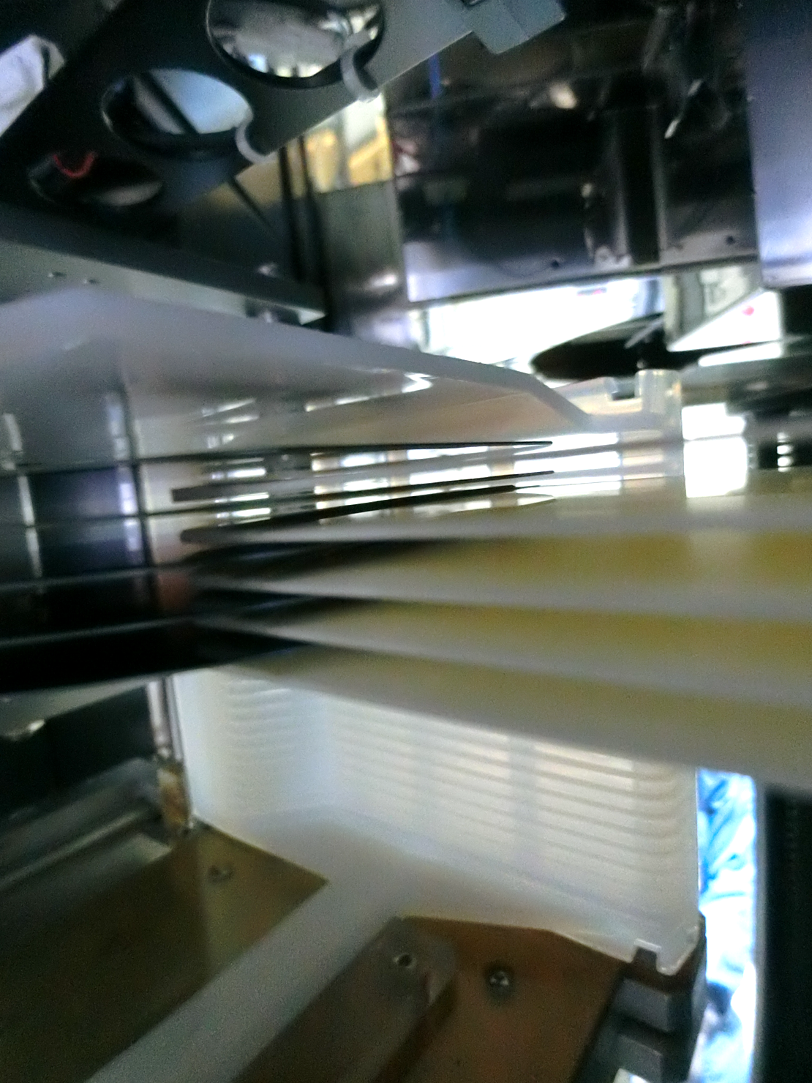
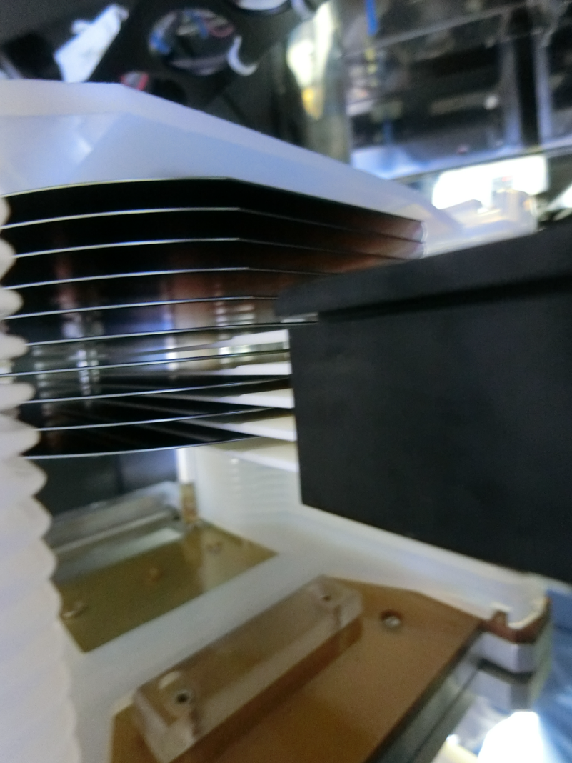
Discipline 2.描述問題及現況掌握Describe the Problem
(WHO detected the problem? WHAT is wrong? State the problem in terms of object and defect. WHERE the problem was first detected, describe location of the detection, lot #, WHEN and HOW it was detected)
EQ Check：
1. F03 fork-5 於 C1 cassette 內中偏低，有間隙無刮傷疑慮

Slide 18
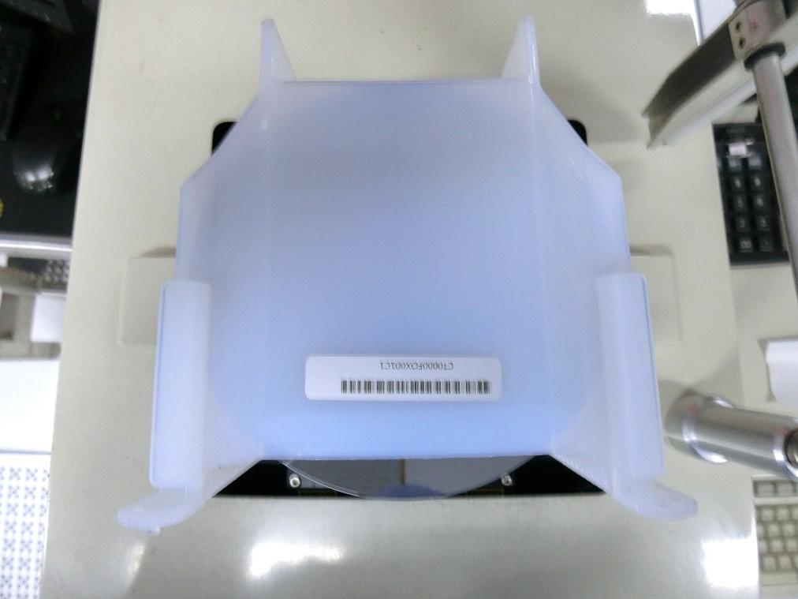
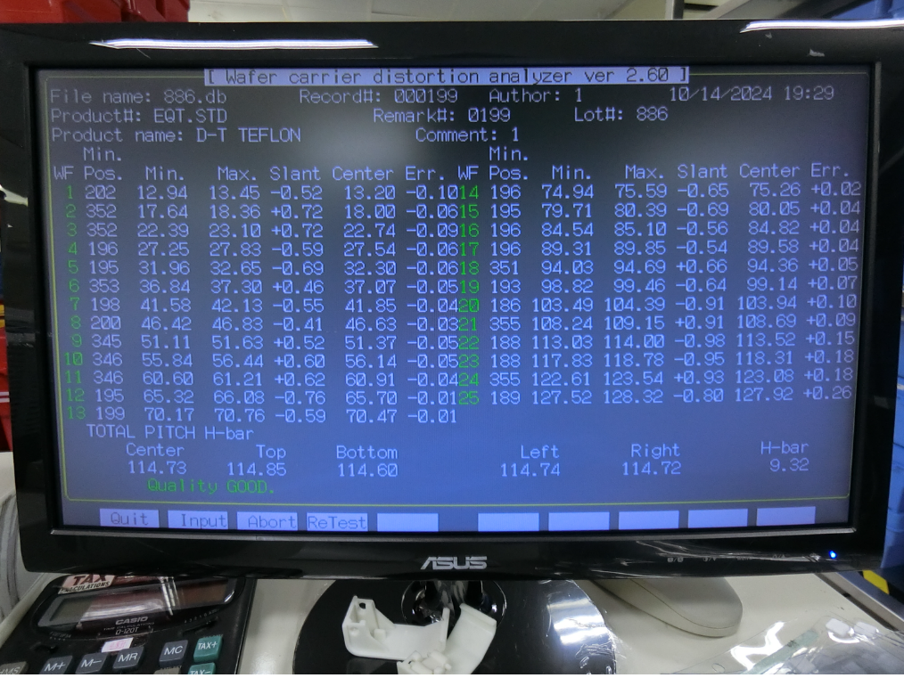
Discipline 2.描述問題及現況掌握Describe the Problem
(WHO detected the problem? WHAT is wrong? State the problem in terms of object and defect. WHERE the problem was first detected, describe location of the detection, lot #, WHEN and HOW it was detected)
EQ Check：
2. F03 cassette CT0000FOX001C1，檢驗*2次皆為 quality good

Slide 19
Discipline 2.描述問題及現況掌握Describe the Problem
(WHO detected the problem? WHAT is wrong? State the problem in terms of object and defect. WHERE the problem was first detected, describe location of the detection, lot #, WHEN and HOW it was detected)
EQ Check：
7. F03 check C1~C6 fork-5 & fork-1 transfer 無刮傷疑慮
8. 檢測 FOX all cassette，結果如下表格，異常 cassette 交領班報廢
FOX cassette 編號 | 檢測結果 | 備註
CT0000FOX001 | C6 quality poor
CT0000FOX002 | C4 & C5 quality poor
CT0000FOX003 | All OK
CT0000FOX004 | C1 quality poor
CT0000FOX005 | C1 & C3 quality poor
CT0000FOX006 | All OK
CT0000FOX007 | C1 quality poor
CT0000FOX008 | C3 quality poor

Slide 20
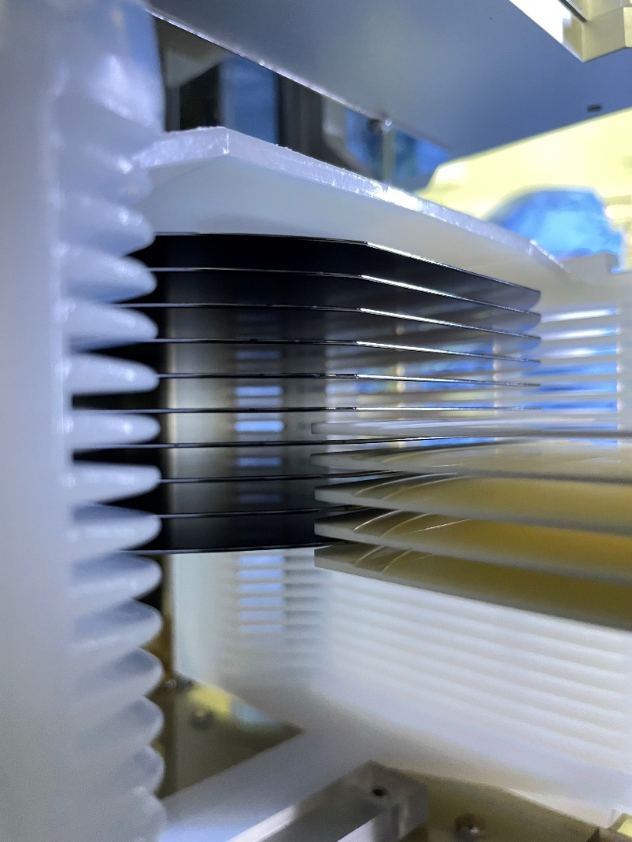
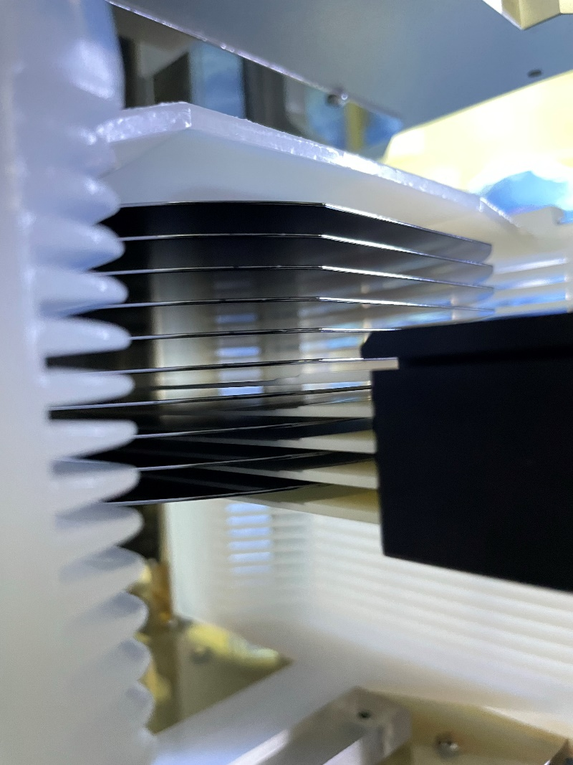
Discipline 2.描述問題及現況掌握Describe the Problem
(WHO detected the problem? WHAT is wrong? State the problem in terms of object and defect. WHERE the problem was first detected, describe location of the detection, lot #, WHEN and HOW it was detected)
EQ Check：
3. F26 fork-5 於 C5 cassette 內置中，無刮傷疑慮

Slide 21
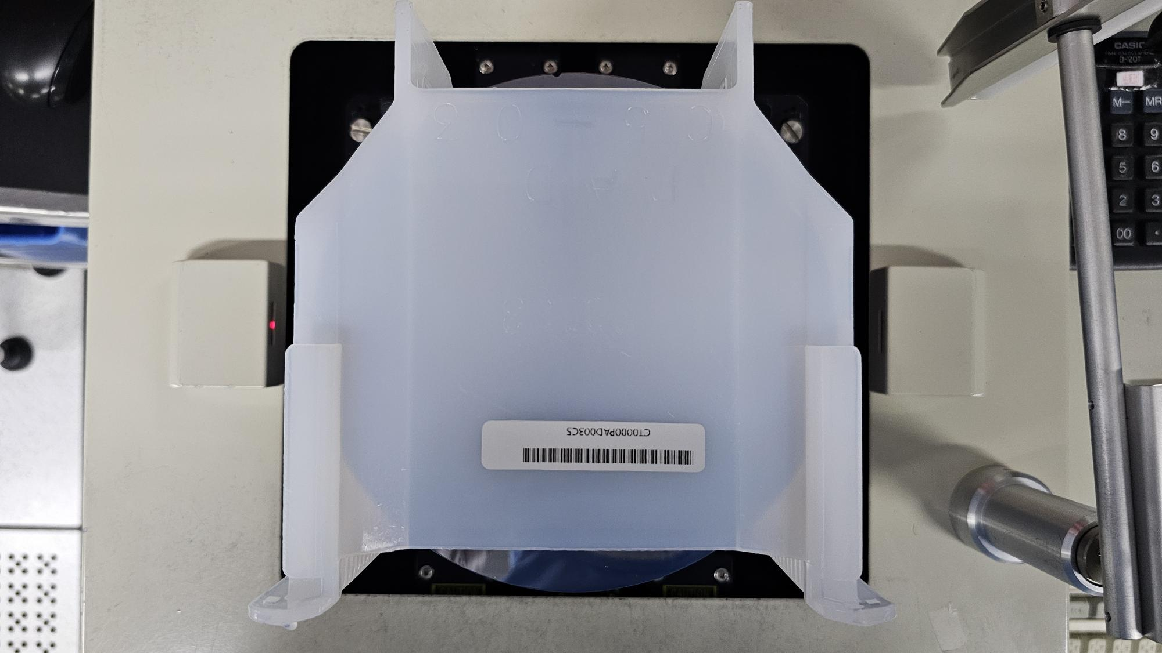
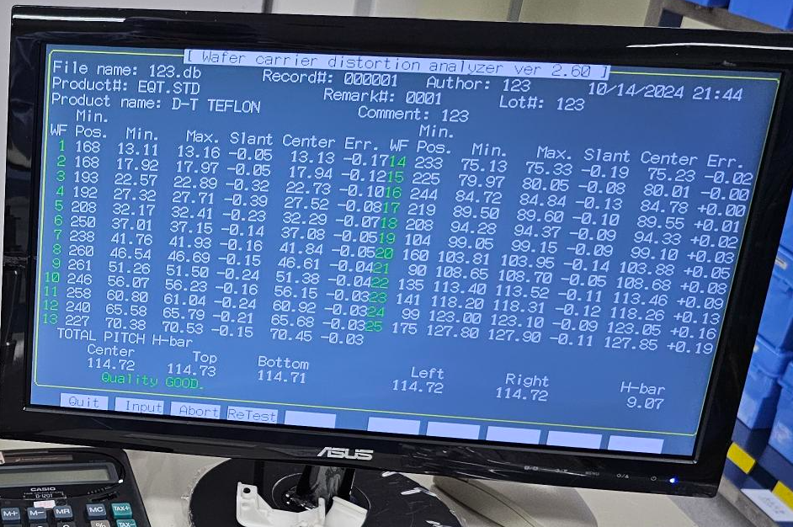
Discipline 2.描述問題及現況掌握Describe the Problem
(WHO detected the problem? WHAT is wrong? State the problem in terms of object and defect. WHERE the problem was first detected, describe location of the detection, lot #, WHEN and HOW it was detected)
EQ Check：
2. F26 cassette CT0000PAD003C5，檢驗*2次皆為 quality good

Slide 22
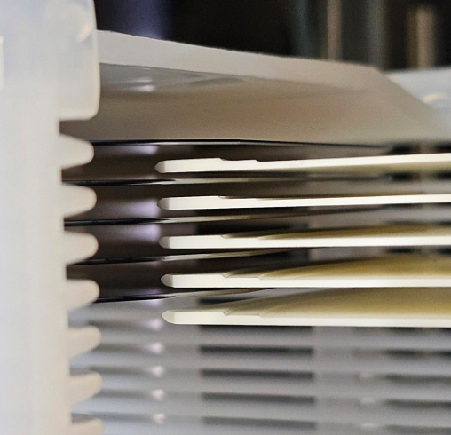
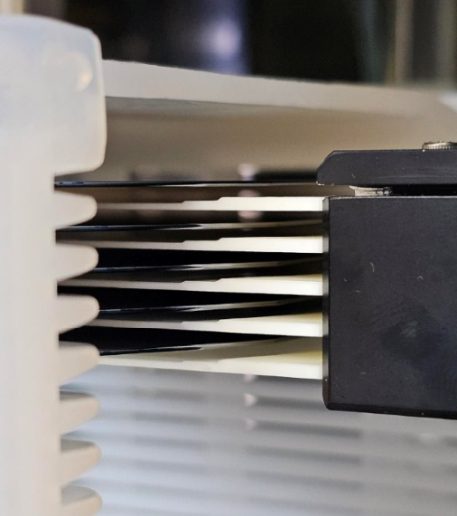
Discipline 2.描述問題及現況掌握Describe the Problem
(WHO detected the problem? WHAT is wrong? State the problem in terms of object and defect. WHERE the problem was first detected, describe location of the detection, lot #, WHEN and HOW it was detected)
EQ Check：
3. F16 fork-5 於 C2 cassette內中偏低，有間隙無刮傷疑慮

Slide 23
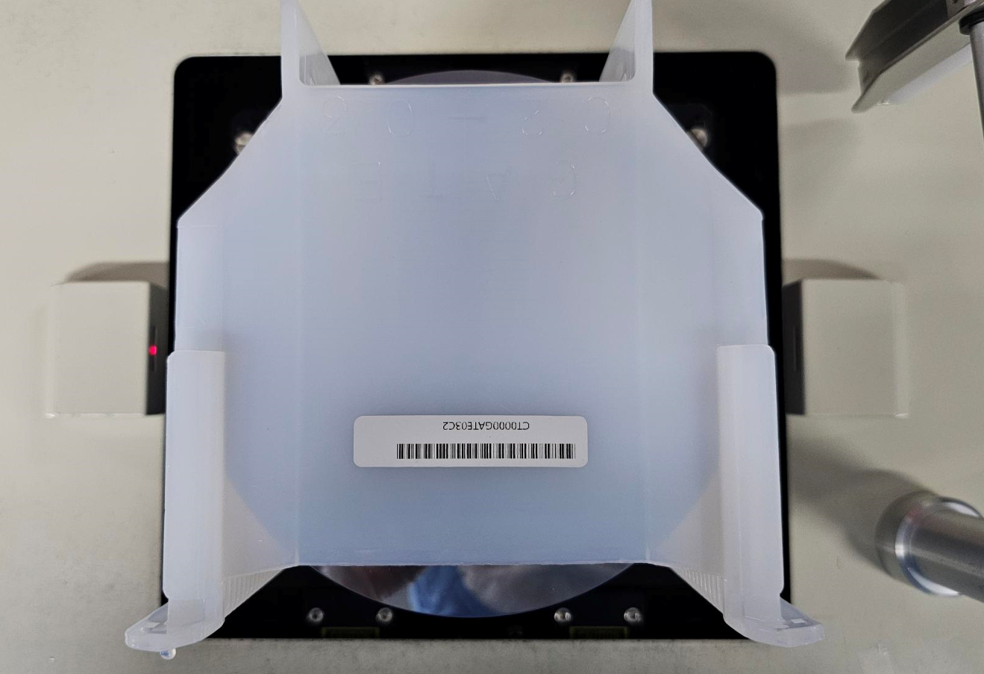
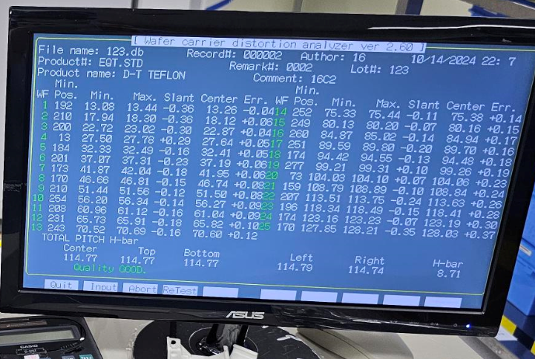
Discipline 2.描述問題及現況掌握Describe the Problem
(WHO detected the problem? WHAT is wrong? State the problem in terms of object and defect. WHERE the problem was first detected, describe location of the detection, lot #, WHEN and HOW it was detected)
EQ Check：
2. F16 cassette CT0000GATE03C2，檢驗*2次皆為 quality good

Slide 24
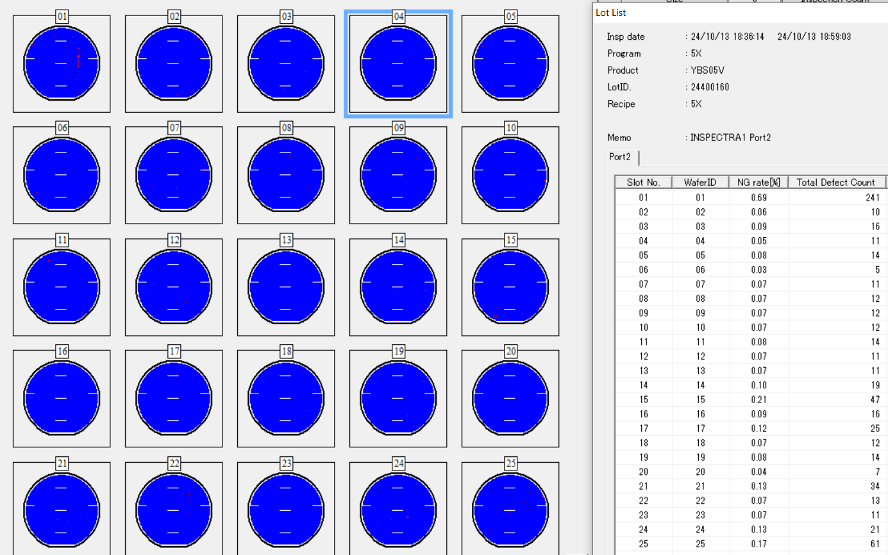

Slide 25
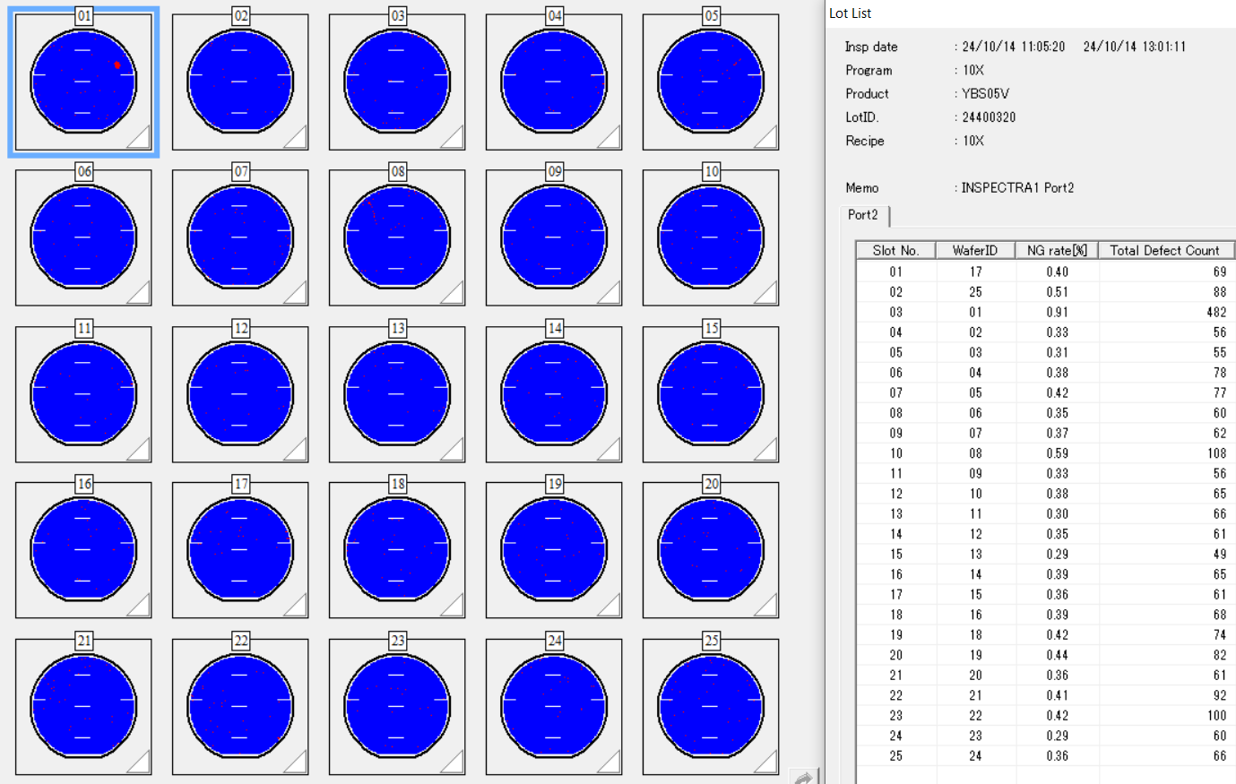

Slide 26
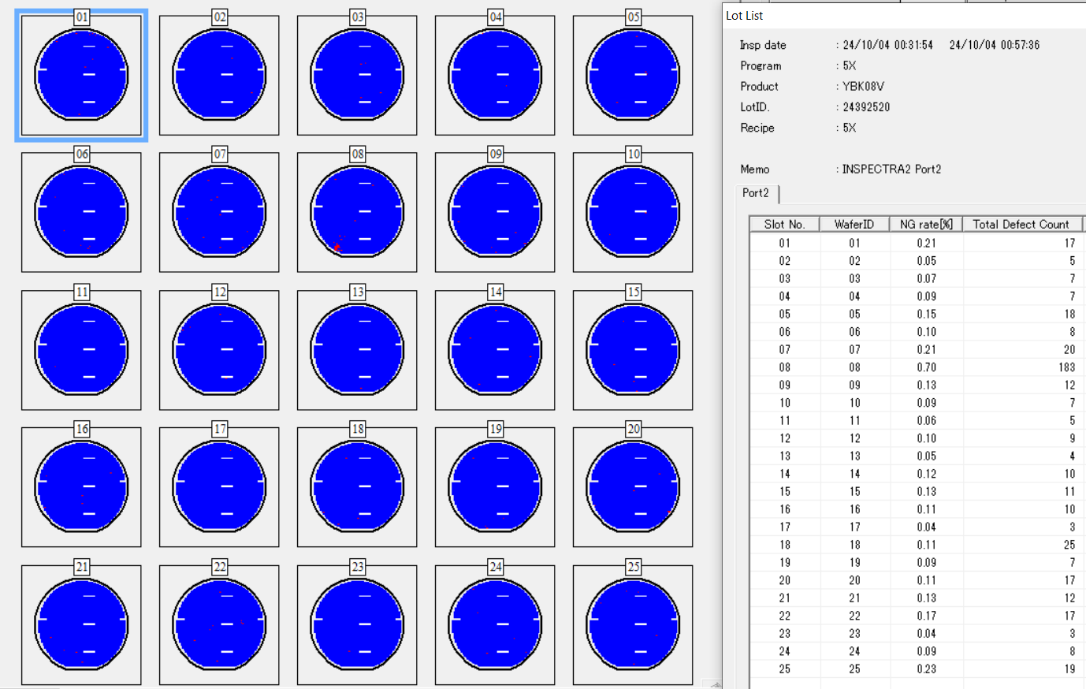

Slide 27
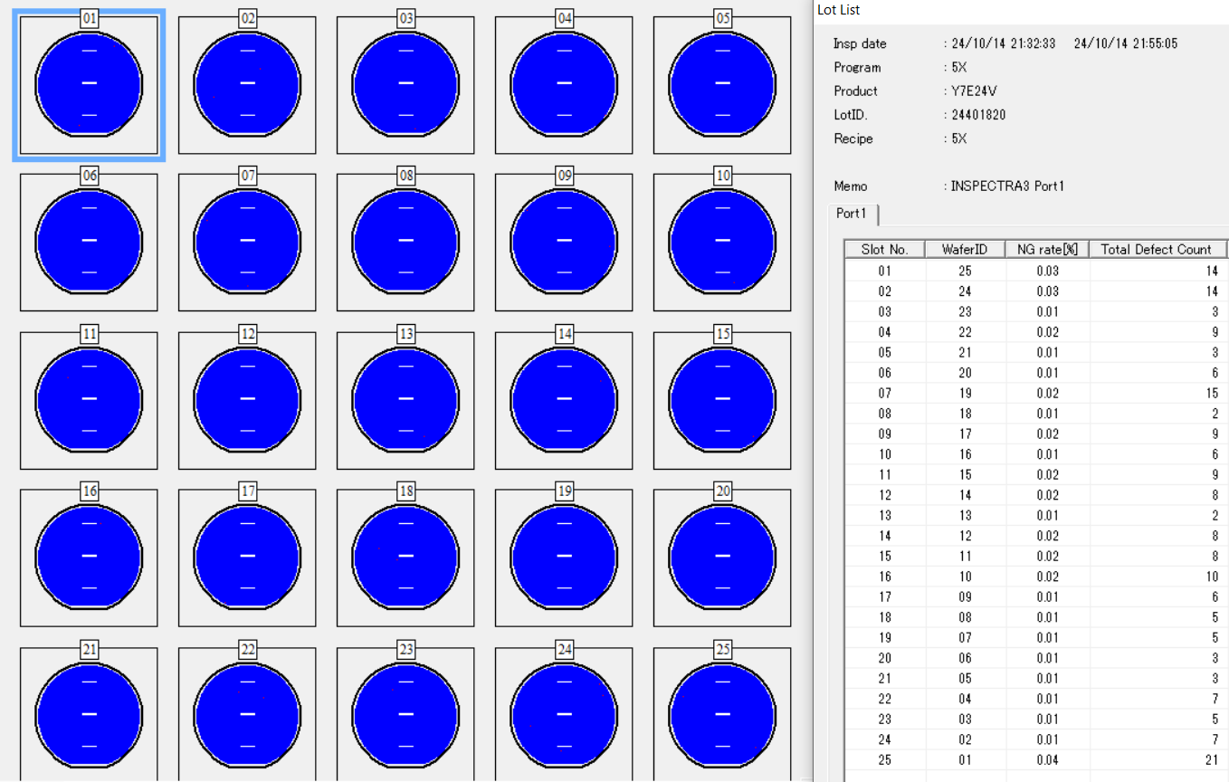
10/13 C1

Slide 28
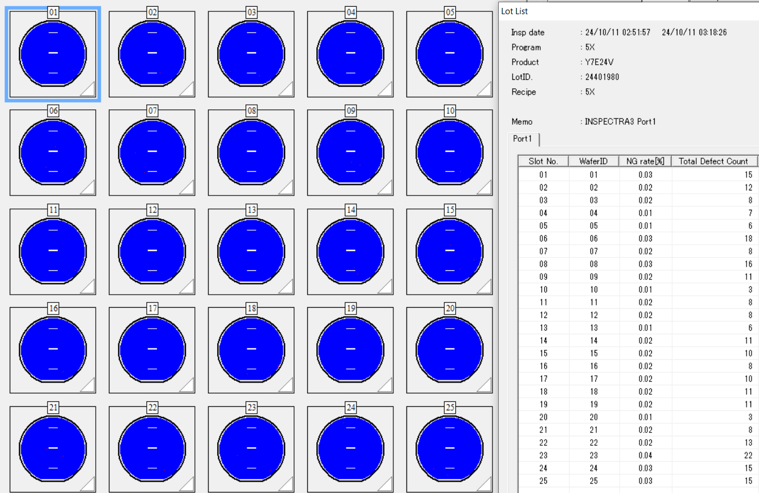

Slide 29
Summary
SEM 結果為 FOX 後刮傷 , 共同機台 F03 C1 zone
Impact lot : 2lot/5pcs , 報廢=2片 (刮傷 >6cm)
Impact date : 10/9~10/10
產品確認 :
1. Issue lot 在 C1 zone
2. Issue 前/當 其他 zone *2 批在 C5 位置 AOI MAP 無刮傷
3. Issue 前/當 C1 zone *2 批在 C1 位置 AOI MAP 無刮傷
機台處理:
F03/F16/F26 FORK-5 C1 確認 transfer ok
Cassette C1 quality poor,交領班報廢

Slide 30
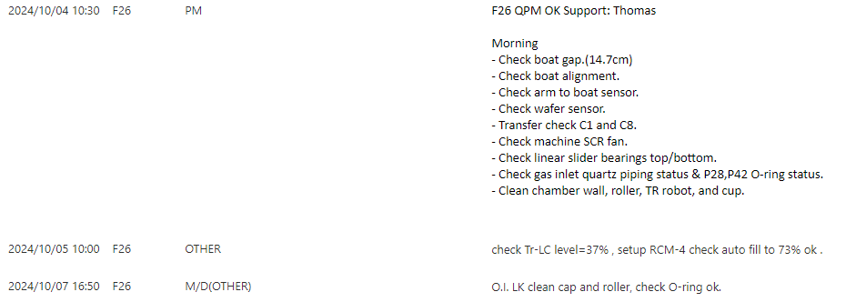
Discipline 2.描述問題及現況掌握Describe the Problem
(WHO detected the problem? WHAT is wrong? State the problem in terms of object and defect. WHERE the problem was first detected, describe location of the detection, lot #, WHEN and HOW it was detected)
Issue run : 24400350 at F26 C5 zone
Issue date : F26 Move-in 10/10 09:13
Check F26 M/D record 無特別異常

Slide 31
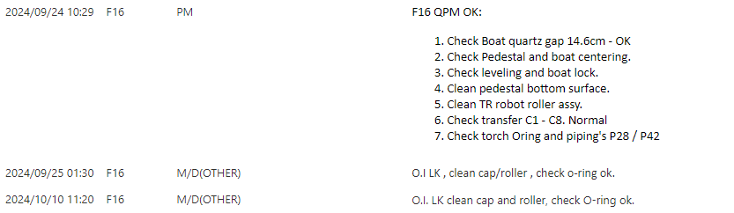
Discipline 2.描述問題及現況掌握Describe the Problem
(WHO detected the problem? WHAT is wrong? State the problem in terms of object and defect. WHERE the problem was first detected, describe location of the detection, lot #, WHEN and HOW it was detected)
Issue run : 24400350 at F16 C2 zone
Issue date : F16 Move-in 10/10 19:56
Check F16 M/D record 無特別異常

Slide 32
Discipline 3.執行及驗證暫時防堵對策 Contain the Problem
(Define and implement containment actions to isolate the effect of problem from any internal/external customer until corrective action is implemented)
F26追貨確認impact 區間
Issue lot 前/後批無 AOI data , 抓 2批產品 24393300、24401670待 AOI 確認刮傷
Issue lot 同batch無 AOI data , 抓C4/6產品24401420、24400370 待 AOI 確認刮傷
確認 F26 當 run C5 產品 – 24391470 Link: SS-6，map normal

Slide 33
Discipline 3.執行及驗證暫時防堵對策 Contain the Problem
(Define and implement containment actions to isolate the effect of problem from any internal/external customer until corrective action is implemented)
F16追貨確認impact 區間
Issue lot 前無 AOI data , 抓 24401380待 AOI 確認刮傷；issue後24400340 AOI map normal
Issue lot 同batch抓C1產品24401460 待 AOI 確認刮傷；同batch C3 AOI map normal
確認 F16 當 run C2 產品 – 24401990 wait AOI data

Slide 34
Discipline 4.定義及驗證真因 (Identify the Root Cause)
(Identify all potential causes which could explain why the problem occurred)
4.1 Non-conformance root cause (defect nature / technical root cause):
a) Failure mechanism:

Slide 35
Discipline 4.定義及驗證真因 (Identify the Root Cause)
(Identify all potential causes which could explain why the problem occurred)
4.1 Non-conformance root cause (defect nature / technical root cause):
a) Failure mechanism:

Slide 36
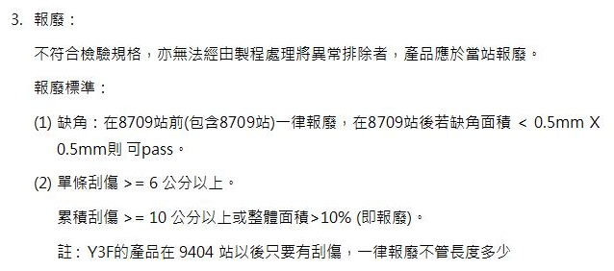
OCAP
貼出此異常事件的 OCAP 處理流程圖, 依此流程所下之決定為….
(OI 在 S210 網頁有 word file)

Slide 37
Discipline 5.擬定及驗證永久改善對策Choose and verify permanent corrective action (列出各項執行之對策並檢核其對策有效性)
5.1 What was the chosen corrective action to correct the root cause? (Add photo or diagram where applicable.)
Short term :
Long term:

Slide 38
Discipline 5.擬定及驗證永久改善對策Choose and verify permanent corrective action (列出各項執行之對策並檢核其對策有效性)
5.1 What was the chosen corrective action to correct the root cause? (Add photo or diagram where applicable.)

Slide 39
Discipline 5.擬定及驗證永久改善對策Choose and verify permanent corrective action (列出各項執行之對策並檢核其對策有效性)

Slide 40
Discipline 5.擬定及驗證永久改善對策Choose and verify permanent corrective action (列出各項執行之對策並檢核其對策有效性)

Slide 41
Discipline 6.實施確認永久改善對策Corrective Actions Implementation

Slide 42
Discipline 7.避免再發Prevent Recurrence (Modify System / Document)
7.1 Systemic Actions:

Slide 43
Discipline 7.避免再發Prevent Recurrence (Modify System / Document)

Slide 44
Discipline 7.避免再發Prevent Recurrence (Modify System / Document)
7.2 Corrective Actions Fan-out: (水平展開):

Slide 45
Discipline 8. Congratulate the Team
Thanks for every member helped in this case.
Reviewed and Approved by:
Name | Department | Position

